Slide 1



FMLA, ADA and the Pregnant Workers Fairness Act

Slide 2
Family Medical Leave Act (FMLA)
Provides up to twelve-weeks total of unpaid leave during a 12-month period for qualified employees for qualifying reasons.
  12-month period begins July 1 and ends June 30 each year
  District could also use a calendar year, or a rolling calendar, which is based on the date an employee’s leave begins.
  Email building supervisors periodically to ensure they know what to look for that may trigger FMLA.

Slide 3
FMLA Obligations
On the employer
  Provide notice of rights to employees
  Provide leave to eligible employees for qualifying conditions
  Return employee to same or nearly identical job on return
  Prohibited from retaliating for seeking or using leave
On the employee
  Notice of need for leave
  Provide certification of need for leave
  Provide recertification as required
  Provide intent to return to work as required
  Provide fitness for duty as required

Slide 4
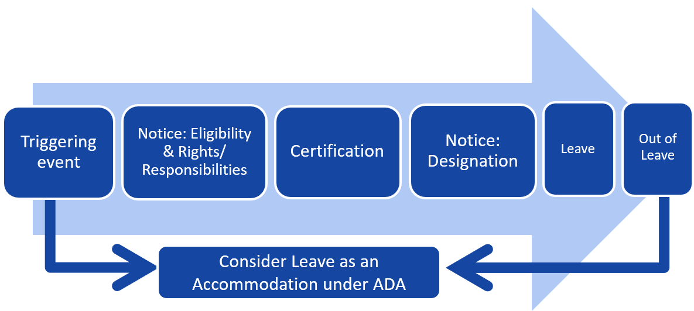
FMLA Process

Slide 5

FMLA Process

Slide 6

Who is covered?

Slide 7
FMLA Qualifying Employees
In order to be eligible for FMLA benefits, an employee must:
  Have worked for their employer for a minimum of 12 months (need not be consecutive – but if there has been a 7-year or more break in service, prior service can generally be disregarded)
  Have worked 1250 hours in the 12 months prior to the leave request (military service is counted toward the 1250 hours)
  Always measure backward from the date of leave to determine eligibility
  50 or more FTE?

Slide 8

What Leave is Covered?
Qualifying Reasons

Slide 9
FMLA Qualifying Reasons
Birth/adoption/foster care placement of a child
Employee’s serious health condition
Care for family members
Qualifying exigency or illness/injury of family service-member

Slide 10

Birth/Bonding
Covers birth, adoption, or foster care placement
Cannot be taken on a reduced or intermittent schedule absent employer consent
Must be taken within the first 12 months of the birth, adoption or placement
Where both spouses work for same employer, limited to 12 weeks between them

Slide 11
Serious Health Condition
Inpatient care (overnight hospitalization)
Incapacity for more than three days with continuing treatment by a health care provider
Incapacity relating to pregnancy or prenatal care
Chronic serious health conditions
Permanent or long-term incapacity, and
Conditions requiring multiple treatments.

Slide 12
Care of Family Members
FMLA provides the right to take leave to care for a child, spouse or parent with a serious health condition.
Note: Care for a child over 18 is not covered unless the child is incapable of self care due to physical or mental disability.

Slide 13
Military Caregiver/
Exigency
Qualifying exigency created by active duty or call to active duty of spouse, son/daughter, parent, or next of kin.
Special rules apply to leave for care of service member who suffers a serious injury or illness in the line of duty.

Slide 14

What Protection it Provides

Slide 15
FMLA Leave Protections
Use of FMLA leave cannot result in the loss of any employment benefit that accrued prior to the start of the employee’s leave (including health insurance benefits)
Eligible employees absent for an FMLA-qualifying reason may generally return to the same position or equivalent position with equivalent pay, benefits, and working conditions at the conclusion of the leave
  District has discretion to assign to different position in a different building, grade level, or classroom
It is unlawful for any employer to interfere with, restrain, or deny the exercise of any right provided under the FMLA
It is unlawful for any employer to discharge or discriminate against any person for opposing any practice made unlawful by the FMLA or for involvement in any proceeding under or relating to the FMLA

Slide 16

Notice Requirements

Slide 17
Employee Notification
For the 1st FMLA qualifying event, an employee notifies by asking for FMLA
– OR –
Giving the employer enough info that a FMLA event occurred (e.g. “I’m pregnant”; “I was in the hospital overnight”)
An employee has an obligation to respond to an employer's questions designed to determine whether an absence is potentially FMLA-qualifying.
Calling in “sick” with nothing more is insufficient.

Slide 18
Employee’s Duty to Notify
Must give employer minimum of 30 days notice of need for leave, to the extent foreseeable
If not foreseeable, must give “as much notice as practicable”

Slide 19

Notice for Follow Up or Subsequent Leave
When an employee seeks leave due to a qualifying reason, for which the employer has previously provided the employee FMLA-leave, the employee must specifically reference either the qualifying reason for leave or the need for FMLA leave

Slide 20
Employer’s Notice Obligations
Employer must provide 5 types of notice:
Satisfy worksite posting requirement AND
Provide notice in employee handbook - (if employer does not have a handbook – can distribute notices to employees upon hiring)
Notice of eligibility within 5 days when an employee asks for FMLA leave (or employer is otherwise on notice of need for leave)
At the same time as the notice of eligibility, must provide notice of employee’s rights and responsibilities 29 CFR 825.300(c)
Within five days of receiving certification, must provide notice of designation of leave

Slide 21

Certifications and Second Opinions

Slide 22
Confirming Need for Leave
Confirmation is through the certification process:
Ask in writing for certification within five business days of notice of need for leave.
Employee has 15 days to complete certification.
There are separate certifications for different types of leave (e.g. “serious health condition” “exigency leave”, “military caregiver.”
Separate leave events should be separately certified.
If certification is timely, complete and sufficient in detail, certification is complete. No further information is required.
Employee not required to authorize direct communication with health care provider.

Slide 23
Incomplete Certification
A certification is incomplete when one or more applicable entries is blank
A certification is insufficient when information is vague, ambiguous or non-responsive
Employer must notify employee of certification deficiencies in writing
Employee has 7 calendar days to cure the deficiency
Leave may be denied if the employee fails to cure the deficiency or fails to provide certification.

Slide 24
Clarification and Authentication of Certifications
If an employee fails to cure deficiencies, an employer may make direct contact with a health care provider to authenticate or clarify a certification (with employee’s permission)
An employee’s failure to authorize such contact is cause for denial of the leave if the certification is unclear.
Contact can be by a health care provider, HR professional, or management official
Employee’s direct supervisor may never make the contact
Employer may not ask for medical information beyond the scope of the form

Slide 25
Second Opinions
An employer, at the employer’s expense can get a 2nd opinion when the employer “has reason to doubt the validity of a medical certification.” 29 CFR 825.307(b)(1)
Context of the provision suggests that “reason to doubt” arises as a result of failure of employee to remedy certification deficiencies and inability to get information from health care provider
Employer chooses 2nd opinion provider, but 2nd opinion provider must not be regularly employed by the employer. 29 CFR 825.307(b)(2).

Slide 26
Third Opinions
If the certification and the 2nd opinion differ and employer may pay for a 3rd opinion. 29 CFR 825.307(c)
Employer and employee must act in good faith to jointly select 3rd opinion provider. 29 CFR 825.307(c)
A party who fails to act in good faith will be subject to the opinion of the opposing party’s provider.

Slide 27
Recertification
Basic rules
  Employees pay for recertification
  Employer may ask employee to recertify no more often than every 30 days and only in connection with an absence, UNLESS
  The minimum duration of the certified leave is more than 30 days, THEN
  The employer must wait for the minimum duration to expire, UNLESS
  The minimum duration is more than six months, THEN
  The employer may request recertification every six months in connection with an absence. 29 CFR 825.308 (a) and (b)

Slide 28
Recertification
Special rules
An employer can ask for a recertification whenever:
  An employee asks to extend an existing leave
  There is a significant change in circumstances described by the previous certification
  The employer receives information that “casts doubt” on the employees stated reason for the absence, or the continuing validity of the existing certification. 29 CFR 825.308(c)(1)-(3)

Slide 29
Recertification
An employee has 15 calendar days to provide the requested recertification
The employer is specifically allowed to “provide the health care provider with a record of the employees absence pattern and ask the provider if the serious health condition and need for leave is consistent with such a pattern.” 29 CFR 825.308(e)
There is no right to a 2nd or 3rd opinion on recertification. 29 CFR 825.308(f).

Slide 30

Special Circumstances

Slide 31

Intermittent Leave

Slide 32
FMLA Intermittent Leave
For qualifying conditions, the full 12 weeks (480 hours for an FTE) can be broken into separate instances of intermittent leave
Employer tracks leave in the lowest increment used to track other leave
Employee on intermittent leave must abide by call-in procedures, absent unusual circumstances preventing compliance

Slide 33

Leave as an Accommodation

Slide 34
Leave as an Accommodation
Americans with Disabilities Act
  Interactive process
  Independent of FMLA inquiry, but should be part of the analysis if employee qualifies for FMLA leave, as well
  Leave can be considered a reasonable accommodation under the law
Recognizing possible triggers and getting the employee to the proper person within the District to handle the request
  Goes back to ensuring that HR handles an employee who is reportedly under the influence of drugs or alcohol, as there may be a health issue in play

Slide 35

Birthing and Bonding Leave

Slide 36
Special Issues with Maternity Leave
Both Parents work for the District: The employees are both entitled to FMLA, but the time is shared between them (for a total of 12 weeks; not 12 weeks each).
Other health issues related to maternity leave:
  Pregnancy/Delivery Complications: Potential Serious Health Issues of Mother
  Health Problems of the Baby

Slide 37

Pregnant Workers Fairness Act Update

Slide 38
Pregnant Workers
Fairness Act Update
  Requires a covered employer to provide a “reasonable accommodation”
    to a qualified employee’s or applicant’s known limitations
    related to, affected by, or arising out of pregnancy, childbirth, or related medical conditions,
    unless the accommodation will cause the employer an “undue hardship.”
  “limitations” are physical or mental conditions
  Title IX Updates reinforce provisions of the PWFA
    Applicants, employees, and students covered

Slide 39
Pregnant Workers
Fairness Act Update
  Very broad language (similar to the ADA)
  Doesn’t change anything about what FMLA additionally requires
  Doesn’t address pregnancy-related discrimination
  Is separate from the PUMP Act
  Supervisors need to be trained to understand provisions and recognize when to refer to HR/CO

Slide 40
What Types of Accommodations?
Examples provided by the EEOC:
  Additional, longer, or more flexible breaks to drink water, eat, rest, or use the restroom;
  Changing food or drink policies to allow for a water bottle or food;
  Changing equipment, devices, or workstations, such as providing a stool to sit on, or a way to do work while standing;
  Changing a uniform or dress code or providing safety equipment that fits;
  Changing a work schedule, such as having shorter hours, part-time work, or a later start time;
  Telework;
  Temporary reassignment;
  Temporary suspension of one or more essential functions of a job;
  Leave for health care appointments;
  Light duty or help with lifting or other manual labor; or
  Leave to recover from childbirth or other medical conditions related to pregnancy or childbirth.

Slide 41

Leave Abuse

Slide 42
FMLA Abuse: “Do’s” for
Responding to FMLA Abusers
  Authenticate/clarify initial certification when inadequate or incomplete
  Stay in touch with employee during leave:
    Instruct employees that they must follow proper call-in procedures
    Inform them if they are taking leave outside of the certified duration
    Make sure employees understand FMLA
  Track absence patterns
  Continue to Address performance concerns
      Use disciplinary memos to address non-FMLA related absences
  Transfer to another position
    Most applicable to non-exempt employees; could transfer to alleviate hardship
    Pay and benefits must remain the same, so that transfer is not punitive

Slide 43
FMLA Abuse: “Do’s” for
Responding to FMLA Abusers
  Most valuable tool: Request Recertification if appropriate
Do not interfere, restrain, or deny the employee of right to FMLA:
  Do not refuse to authorize FMLA for an eligible employee that has followed procedure
  Do not discourage employee from using FMLA
  Do not use the employee’s request for FMLA as a negative factor in employment actions
Bottom Line: Seek complete and sufficient certification and recertification where appropriate and maintain an open dialogue with employees, but do not prevent eligible employees from taking leave.

Slide 44

Questions?

Slide 45




Check out our podcast!
Follow us on social media!
#edcounsel
#trustedcounsel

Slide 46
Thank you!

